Slide 1

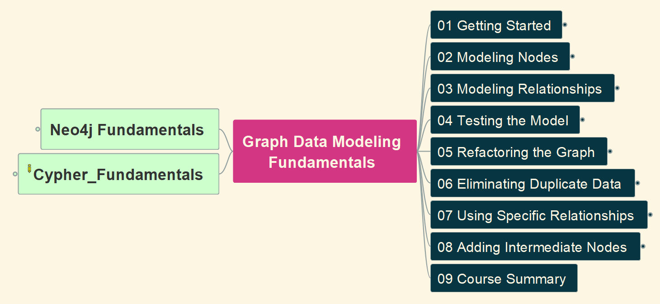

Graph Data Modeling Fundamentals
00
Opening &
Introduction

Slide 2
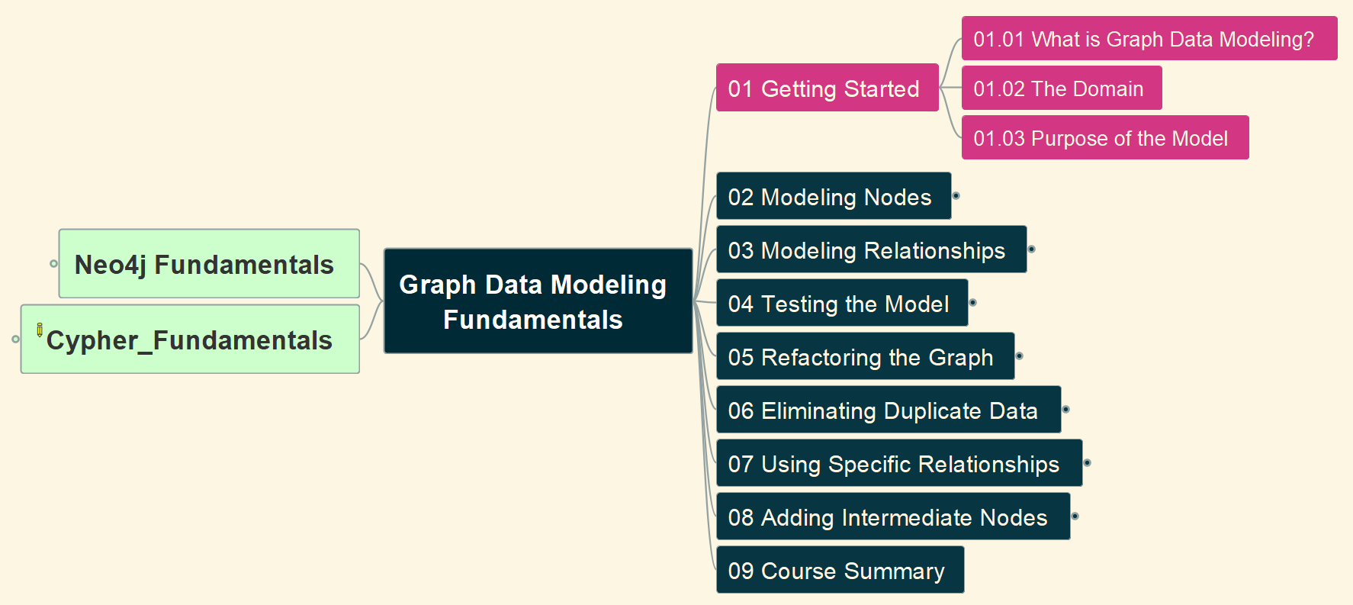
1. Getting Started (1)
Graph Data Modeling Fundamentals
01

Slide 3
1. Getting Started (2)
Graph Data Modeling Fundamentals
02

Slide 4
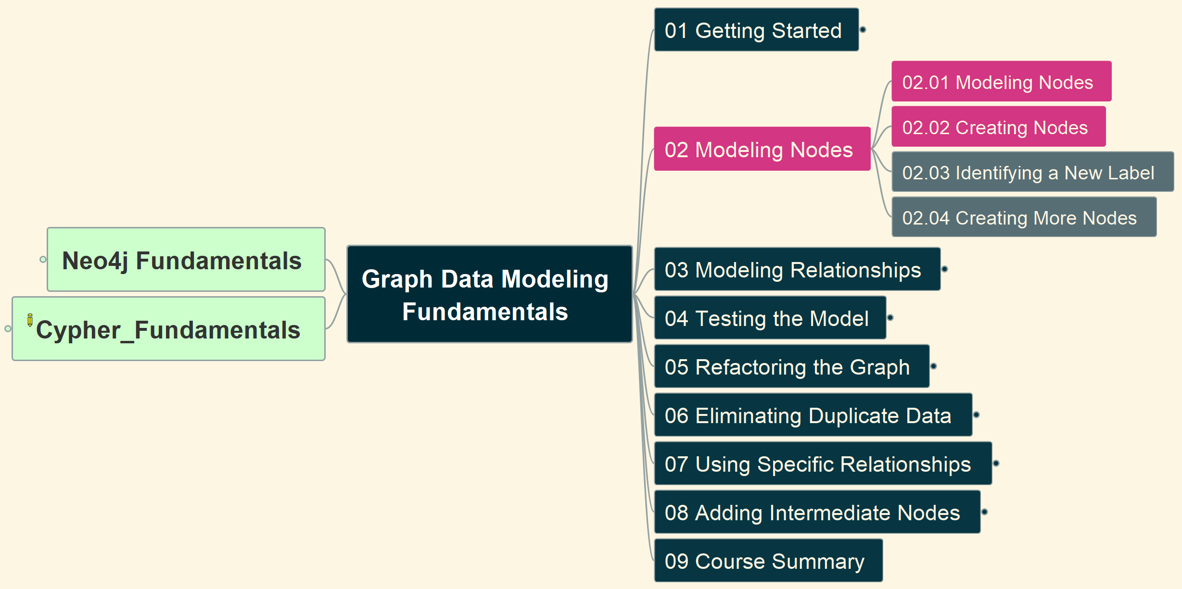
2. Modeling Nodes (1)
Graph Data Modeling Fundamentals
03

Slide 5
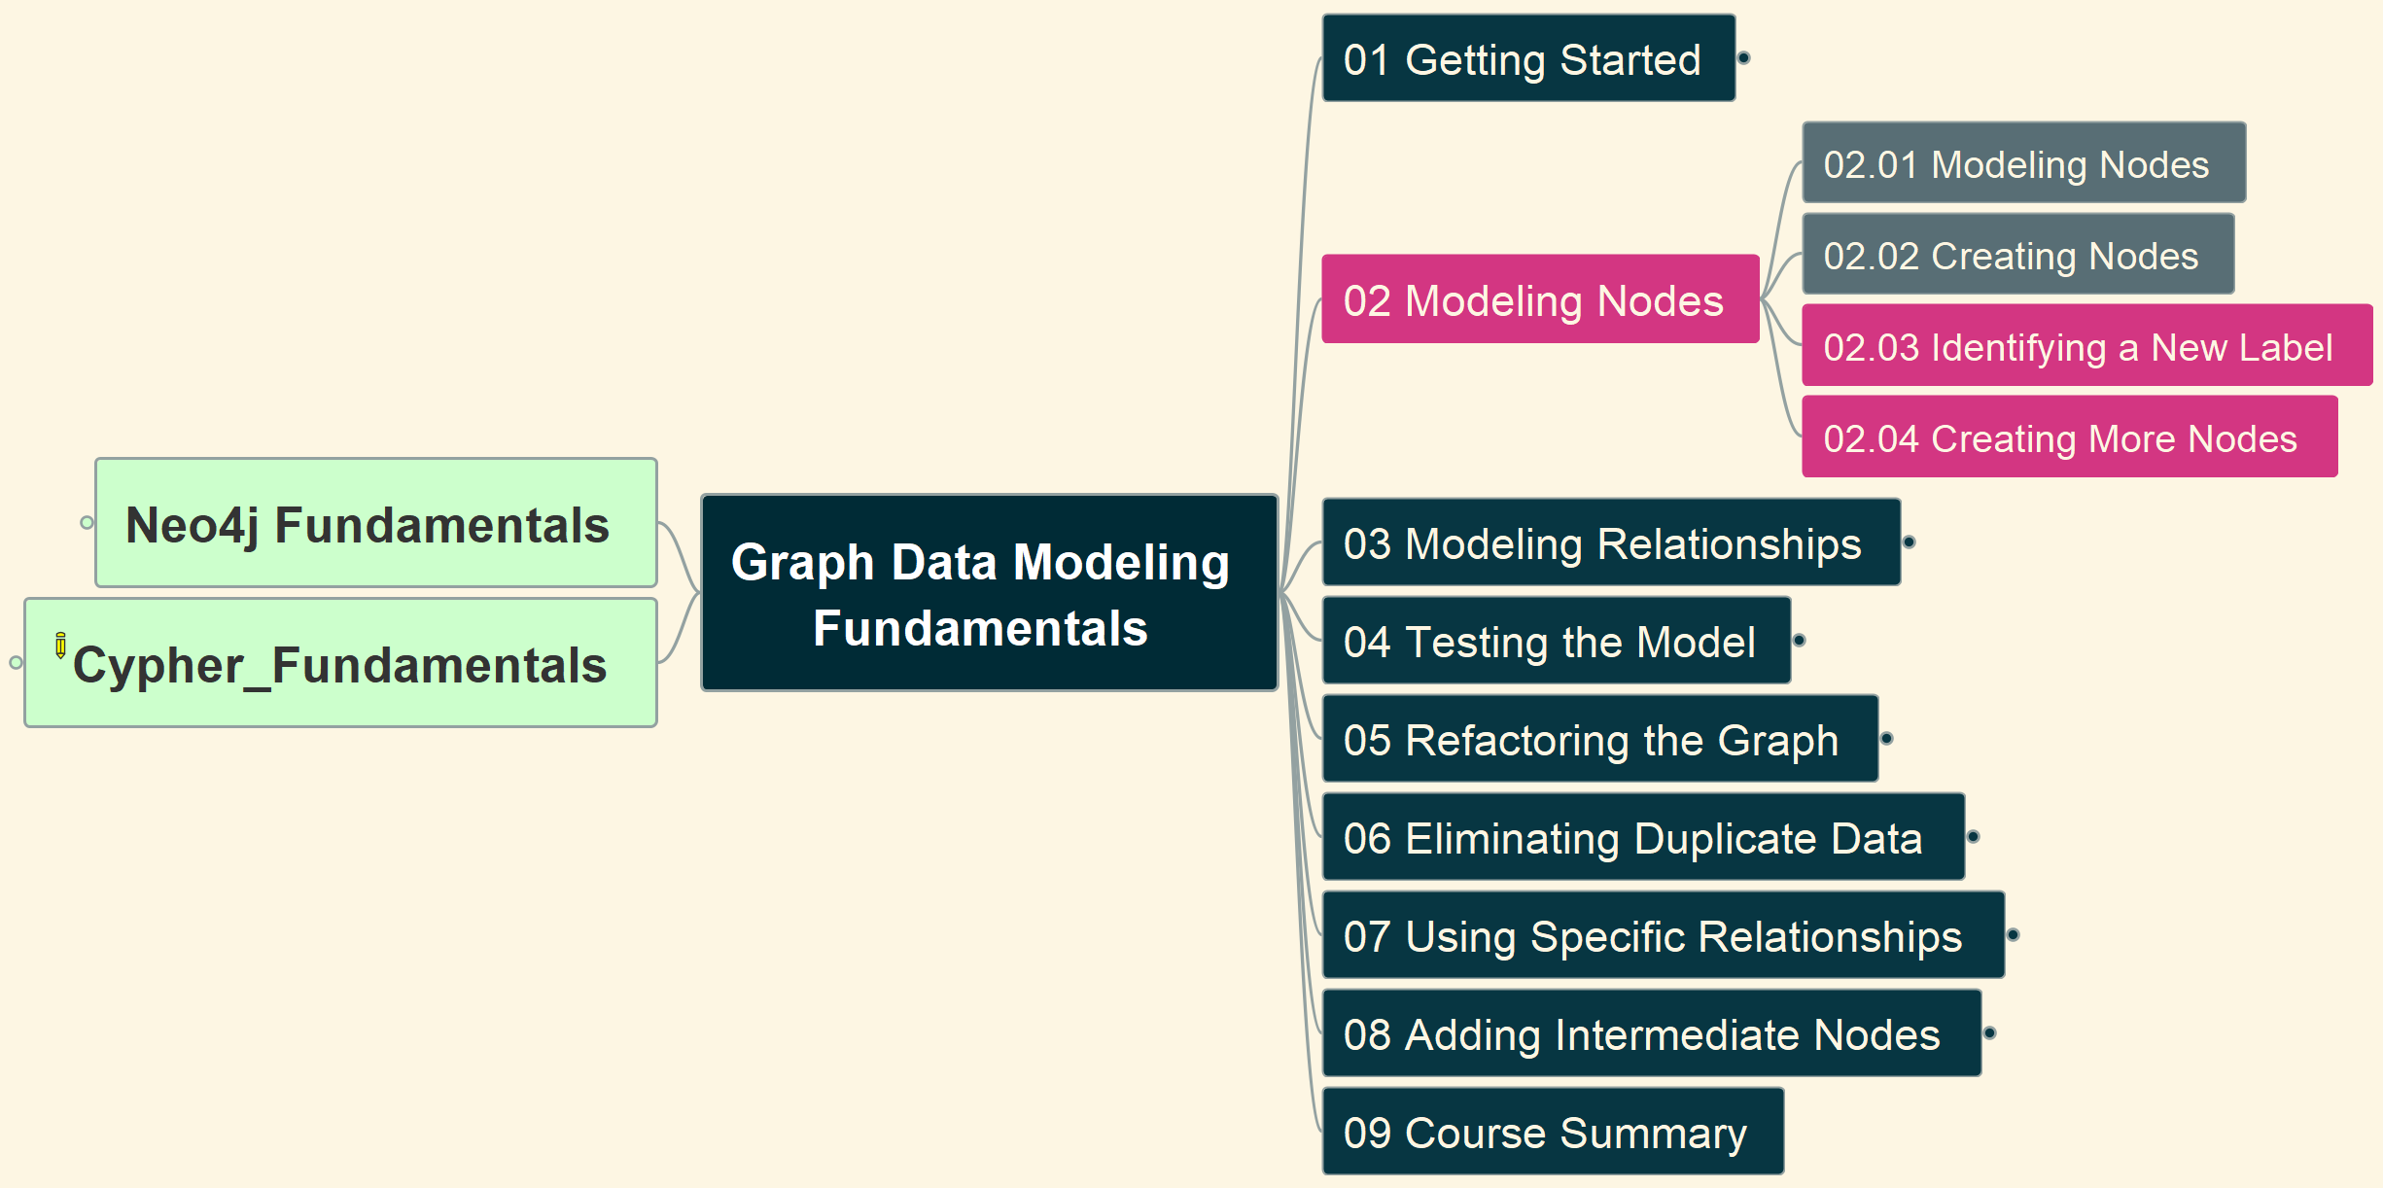
2. Modeling Nodes (2)
Graph Data Modeling Fundamentals
04

Slide 6
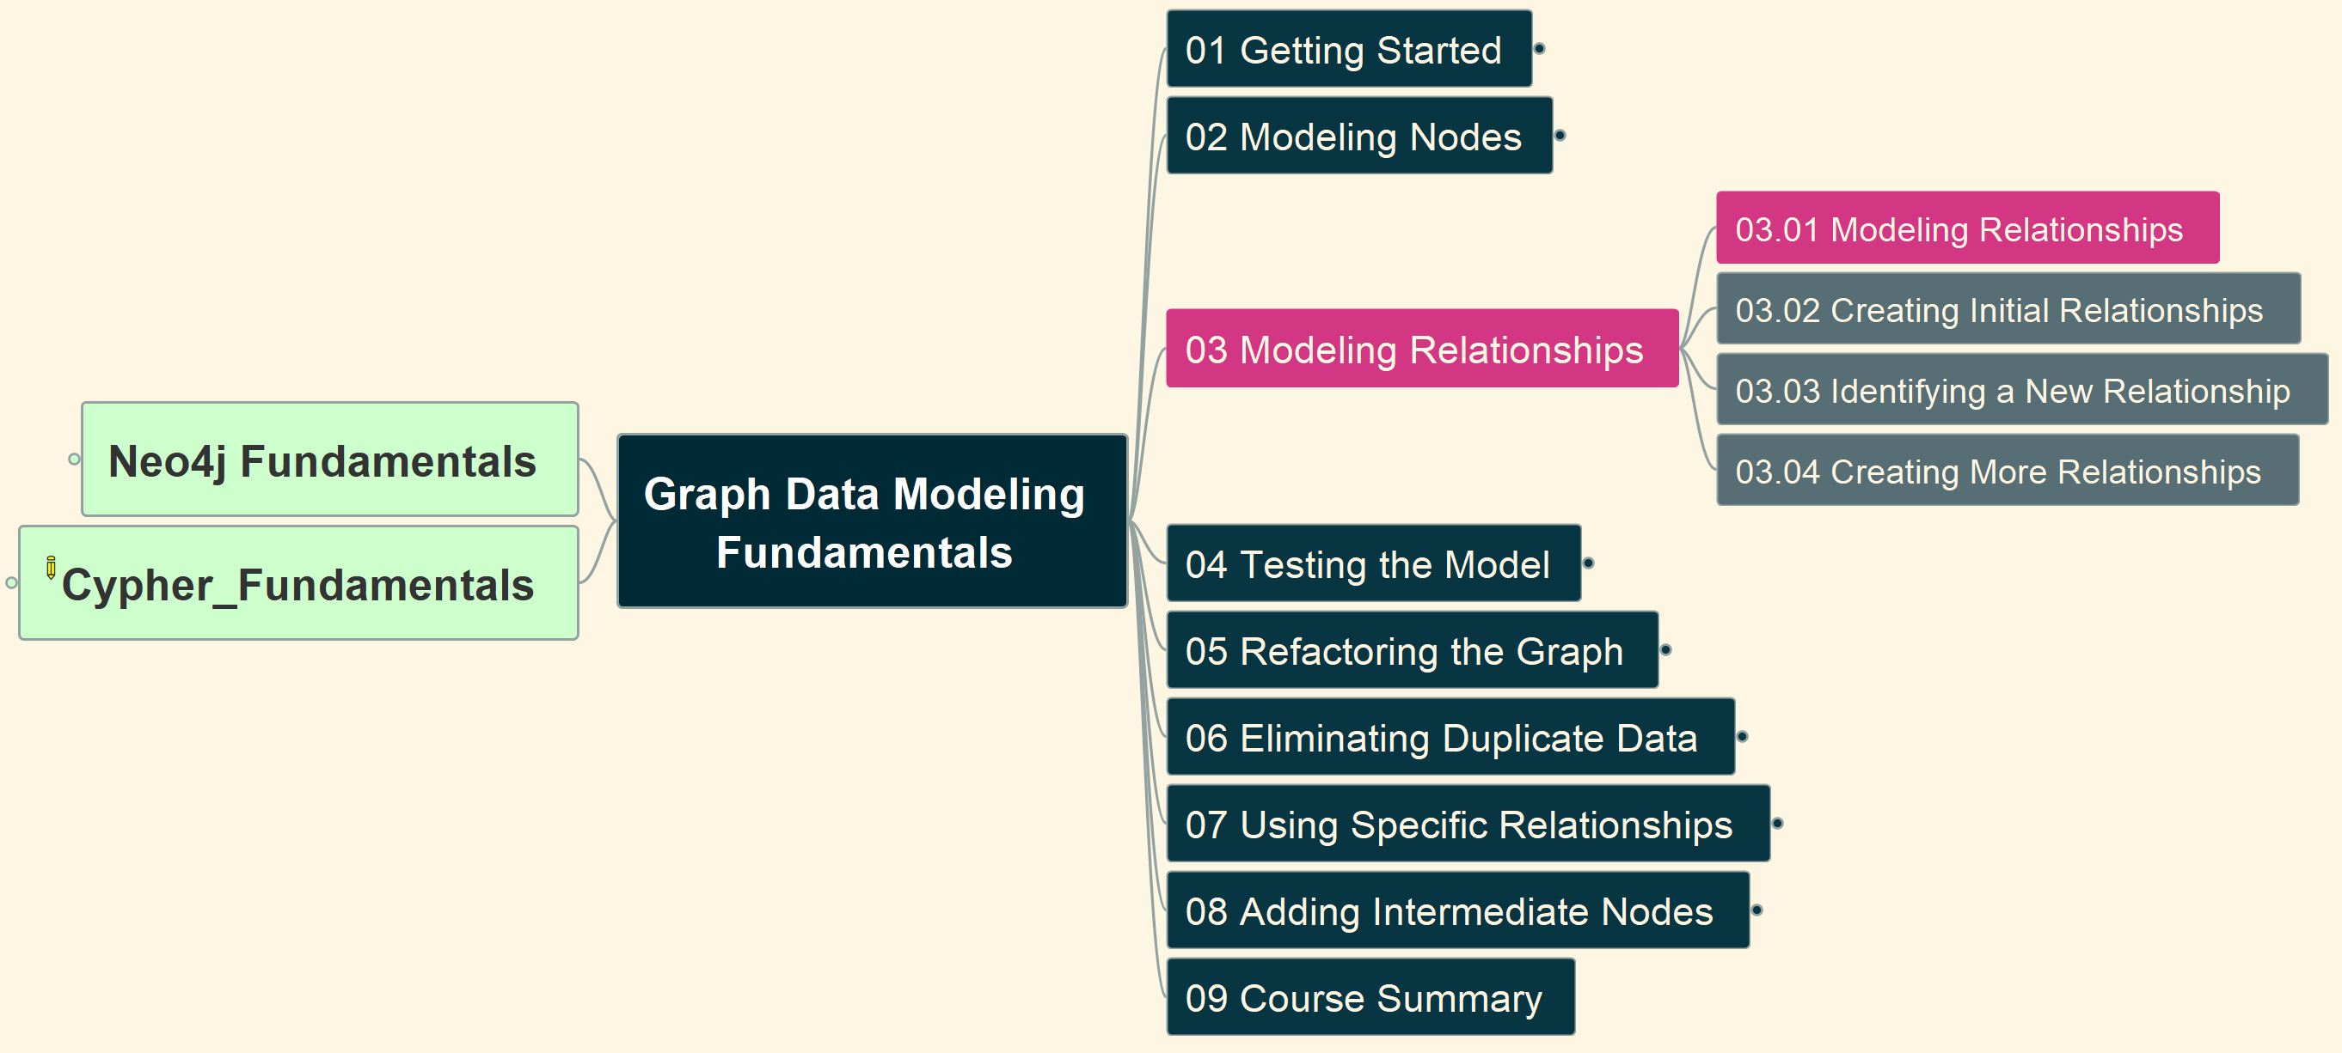
3. Modeling Relationships (1)
Graph Data Modeling Fundamentals
05

Slide 7
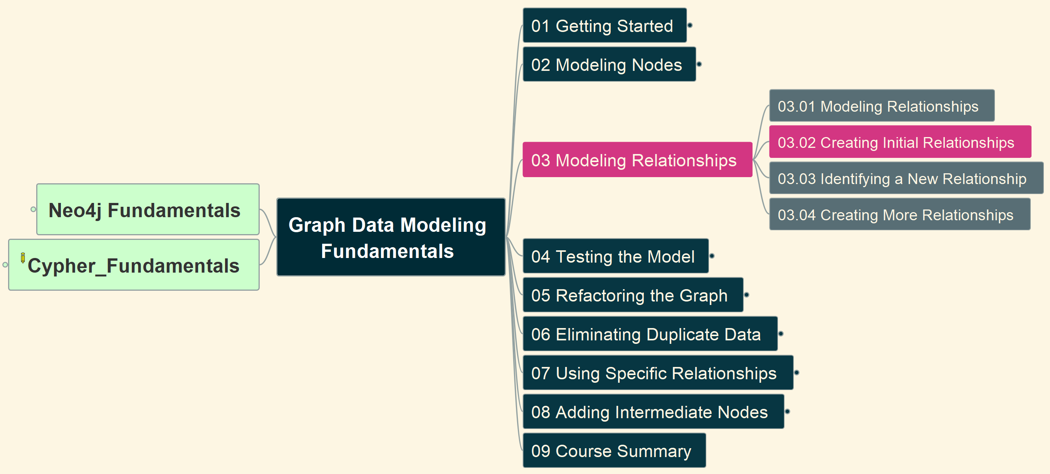
3. Modeling Relationships (2)
Graph Data Modeling Fundamentals
06

Slide 8
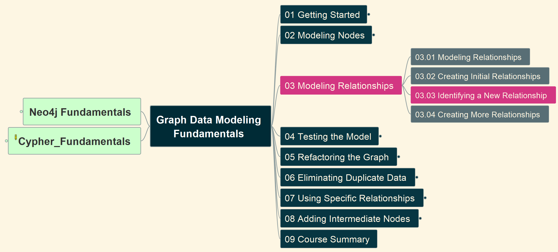
3. Modeling Relationships (3)
Graph Data Modeling Fundamentals
07

Slide 9

3. Modeling Relationships (4)
Graph Data Modeling Fundamentals
08

Slide 10
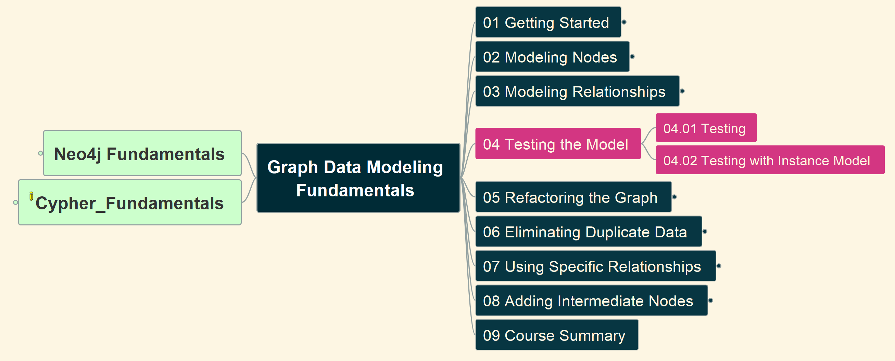
4. Testing the Graph Model
Graph Data Modeling Fundamentals
09

Slide 11
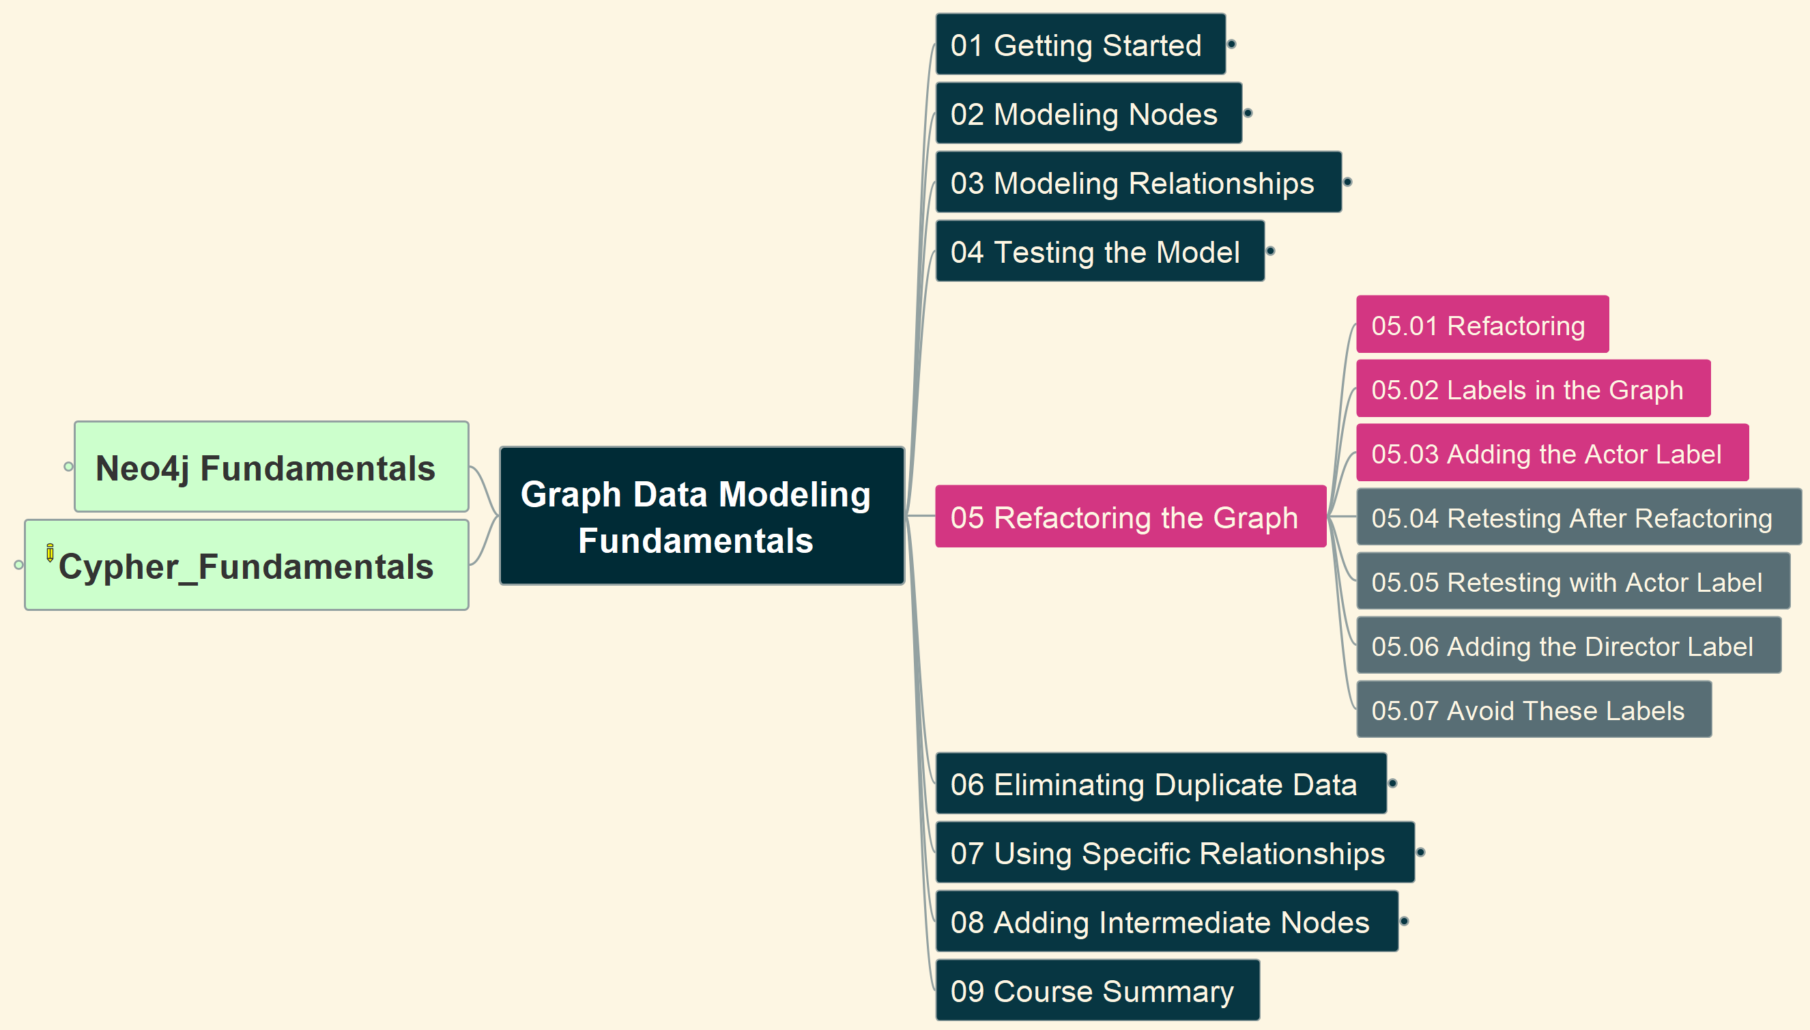
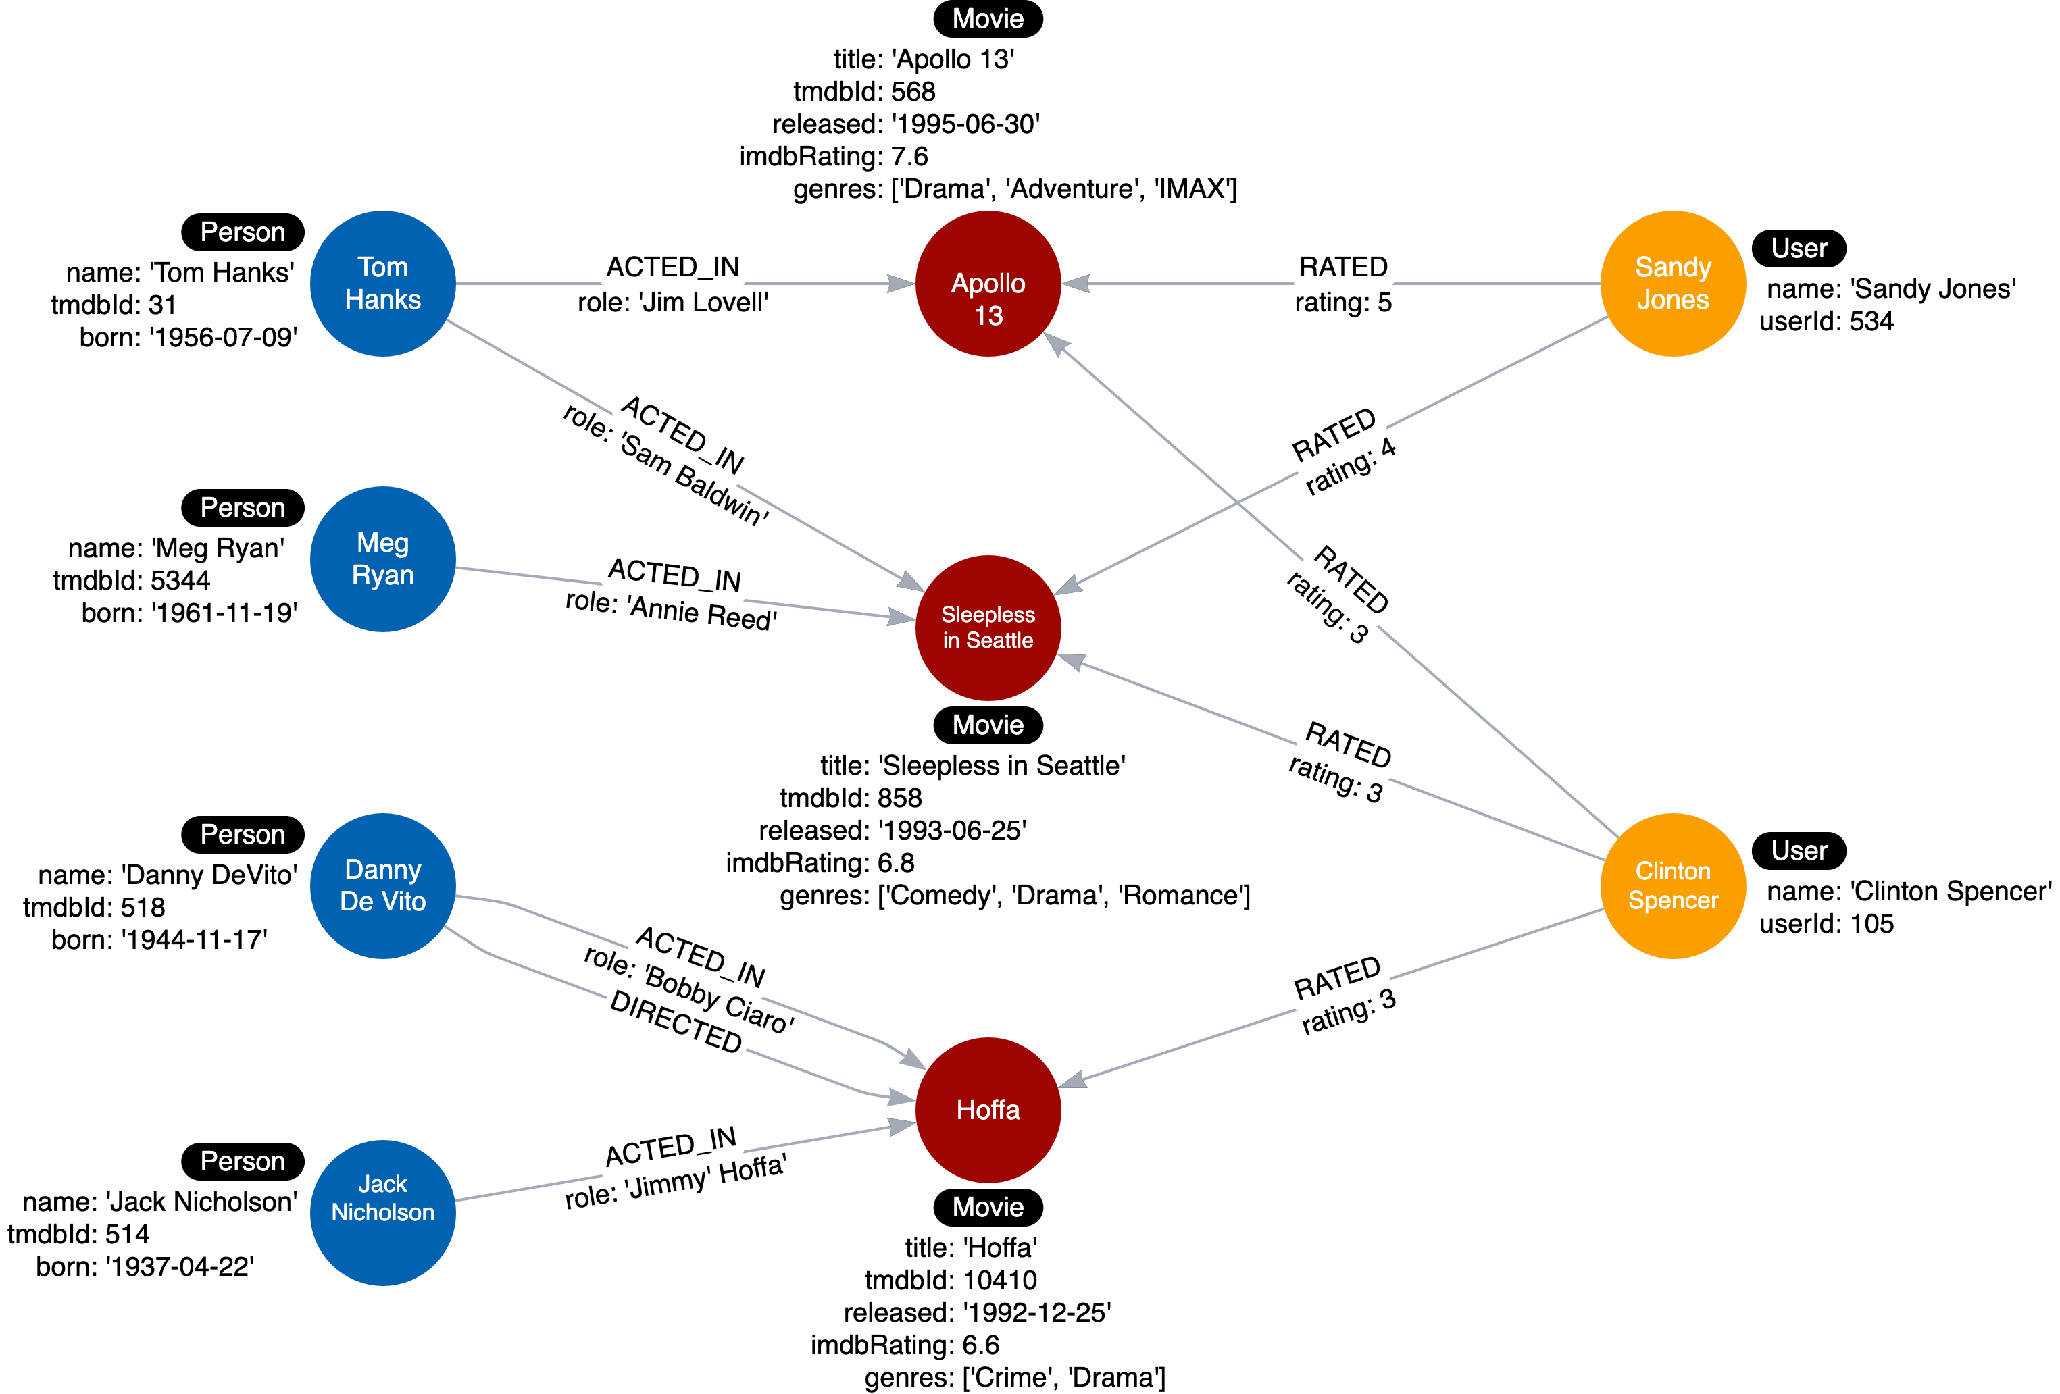
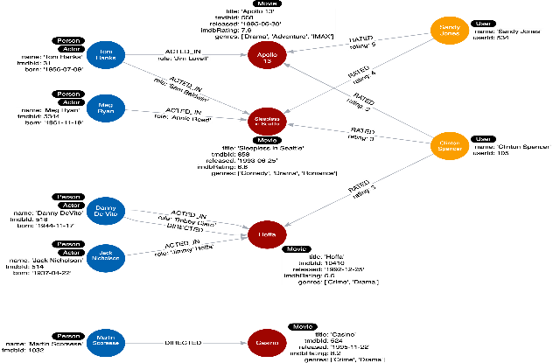
5. Refactoring Graph (1)
Graph Data Modeling Fundamentals
10

Slide 12
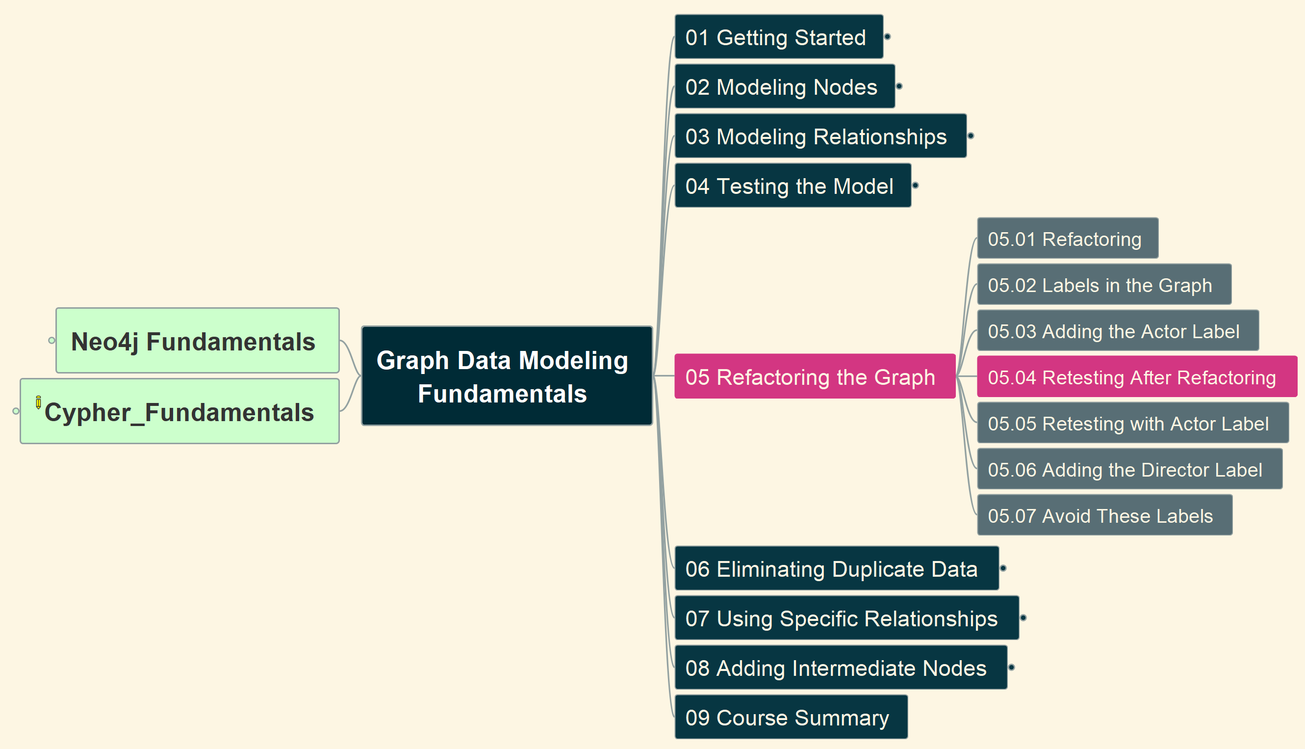
5. Refactoring Graph (2)
Graph Data Modeling Fundamentals
11

Slide 13
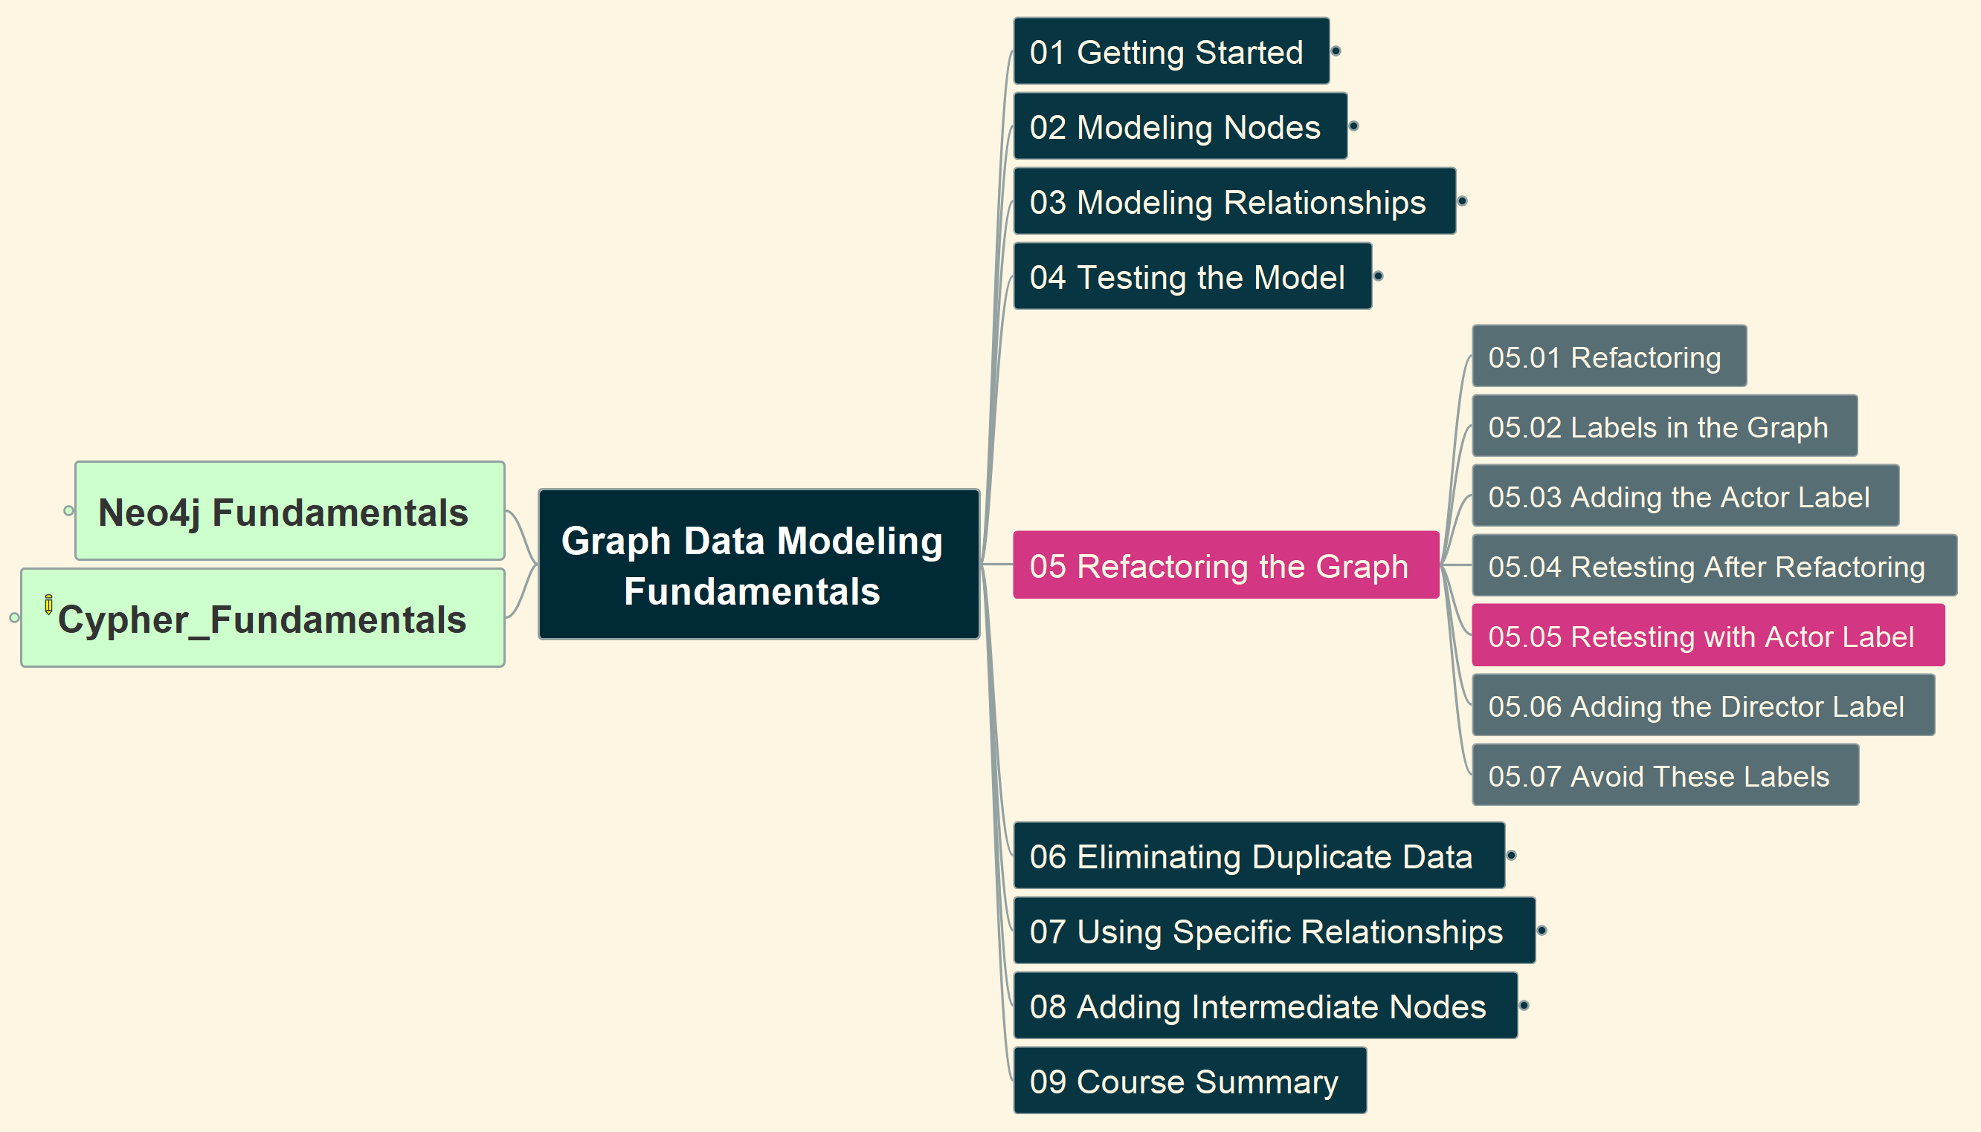
5. Refactoring Graph (3)
Graph Data Modeling Fundamentals
12

Slide 14
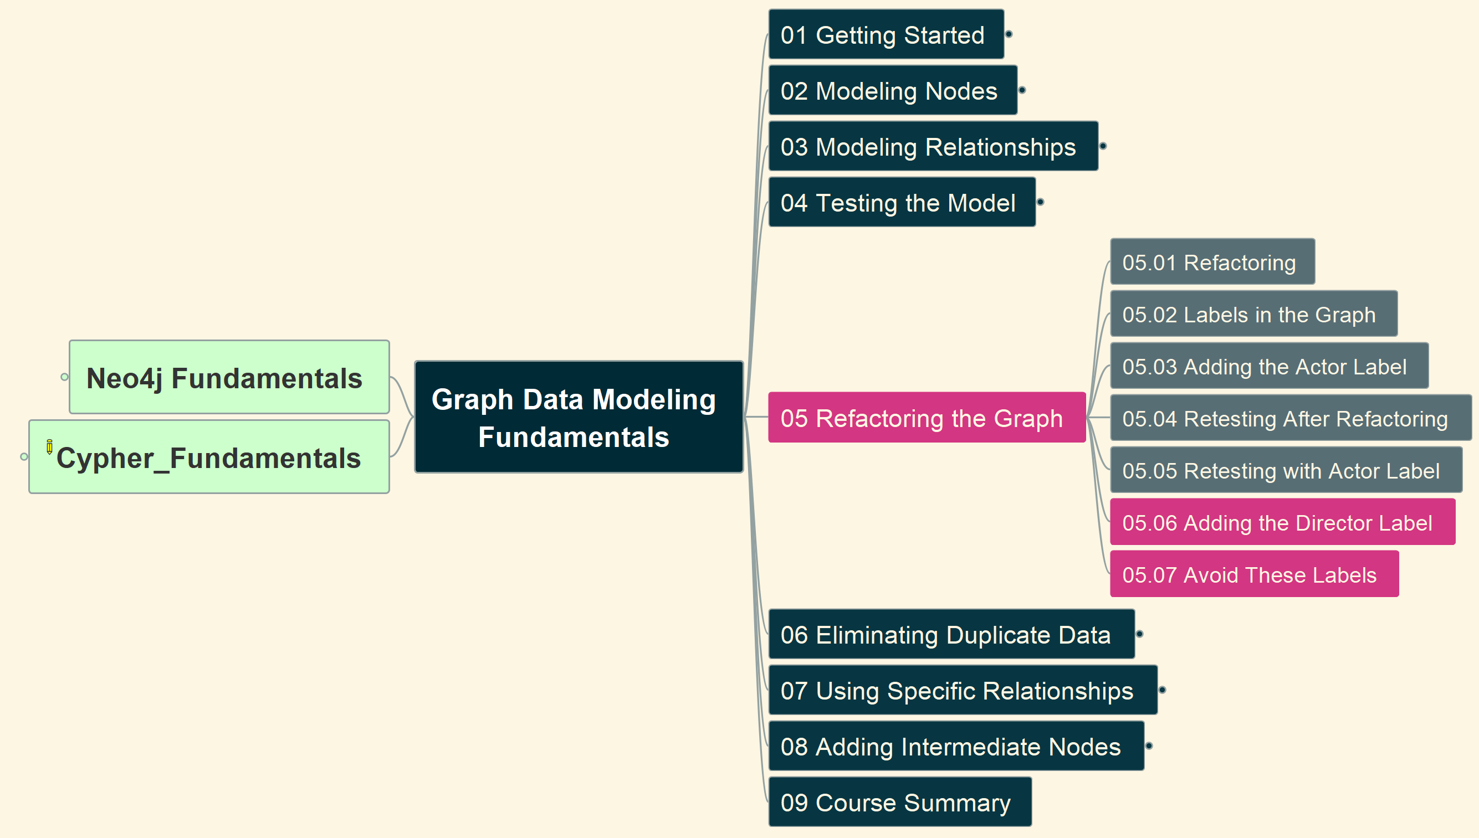
5. Refactoring Graph (4)
Graph Data Modeling Fundamentals
13

Slide 15
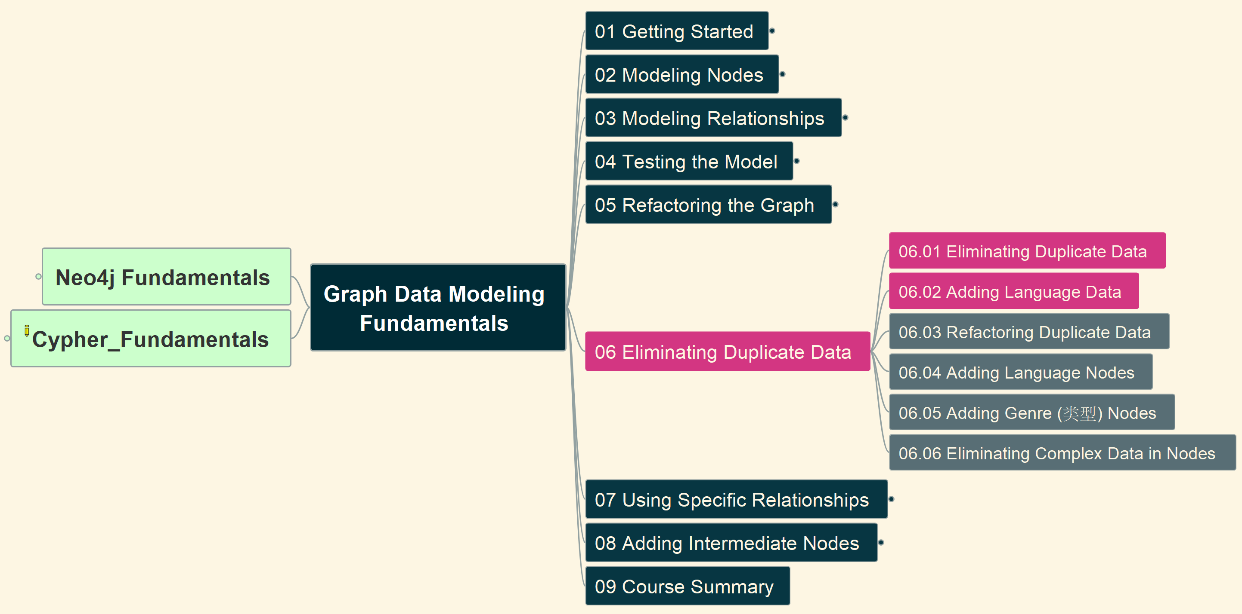
6. Eliminating Duplicate Data (1)
Graph Data Modeling Fundamentals
14

Slide 16
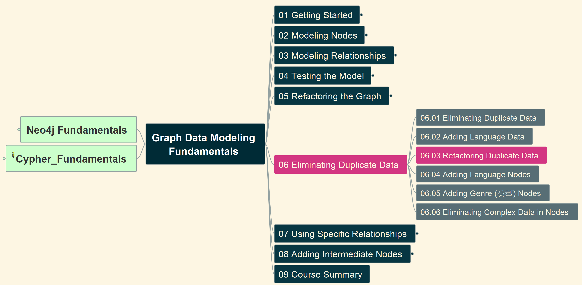
6. Eliminating Duplicate Data (2)
Graph Data Modeling Fundamentals
15

Slide 17
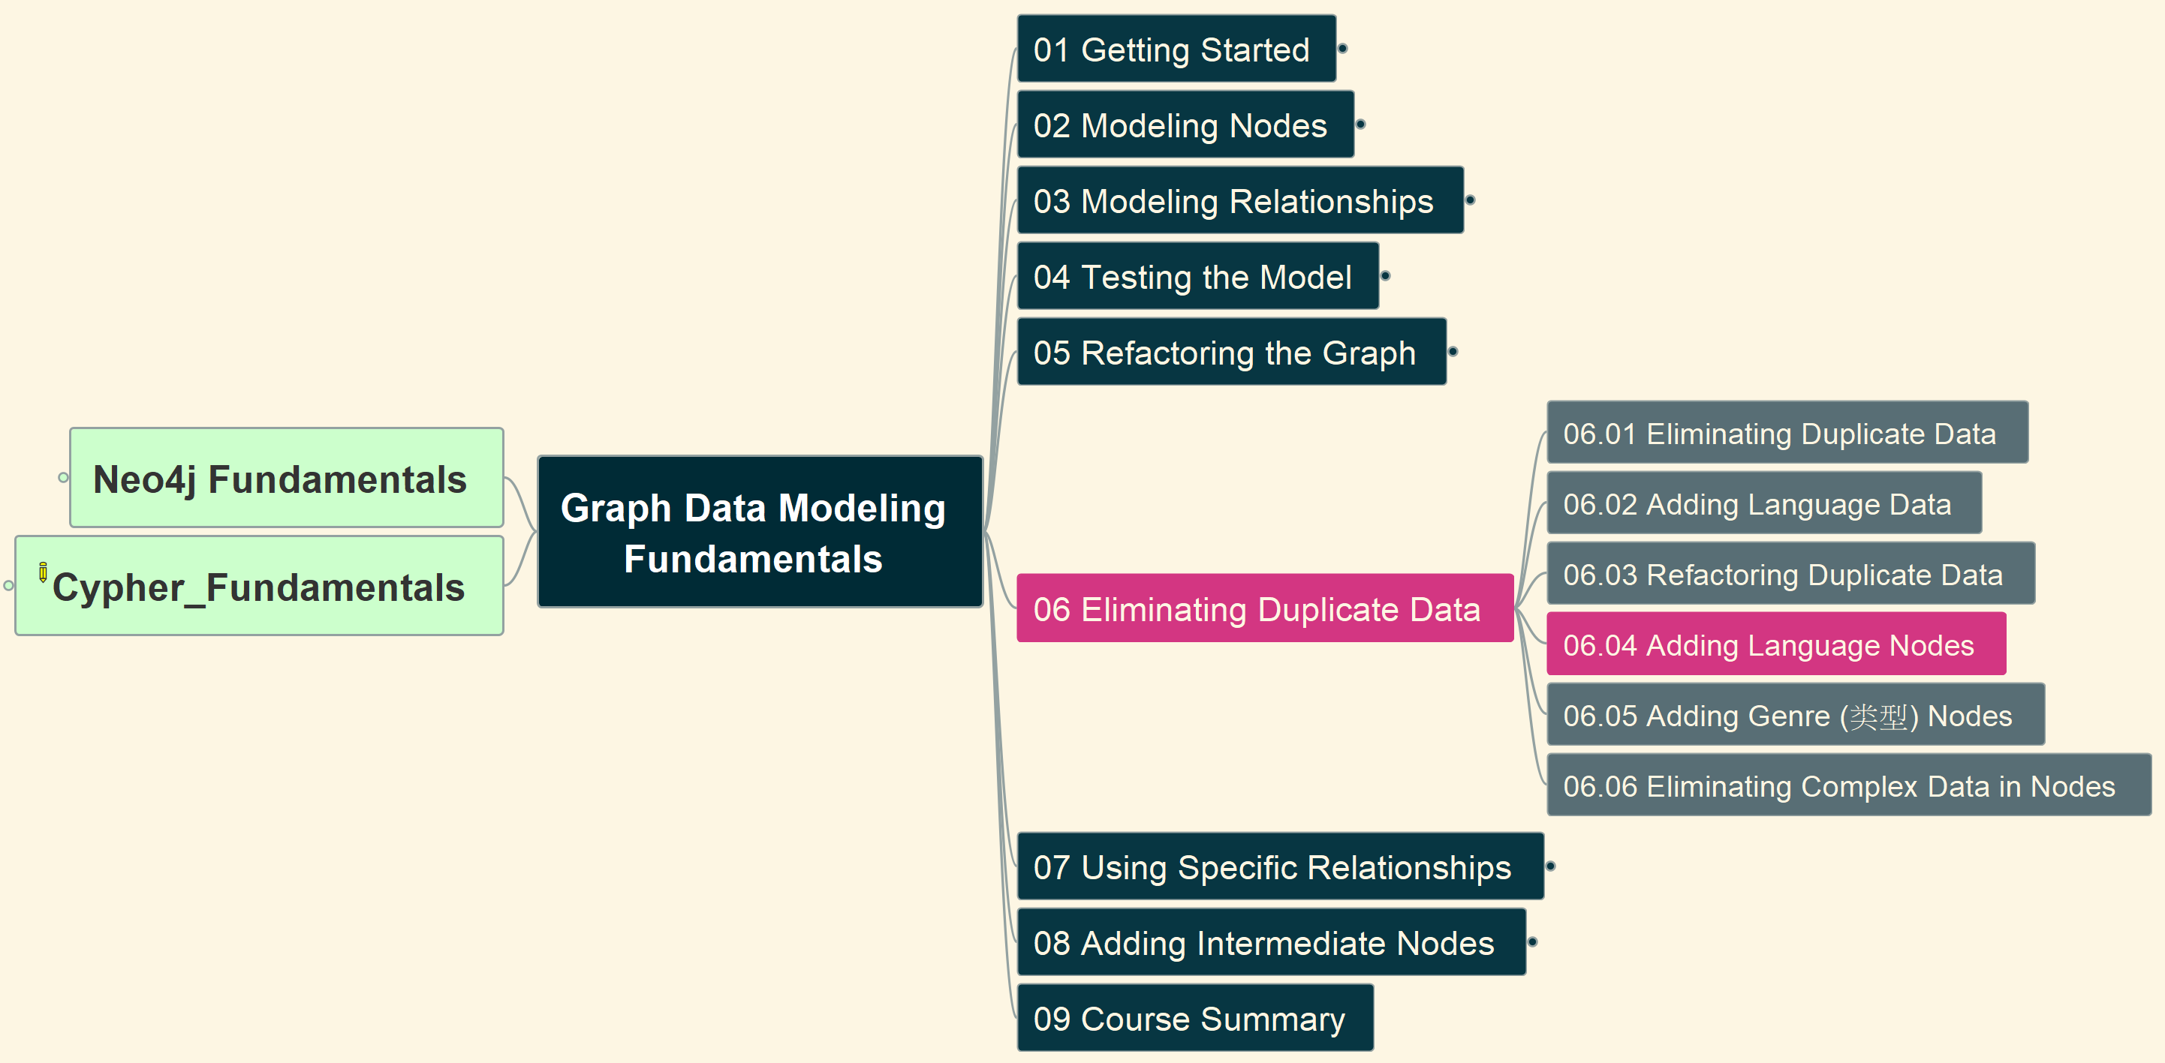
6. Eliminating Duplicate Data (3)
Graph Data Modeling Fundamentals
16

Slide 18
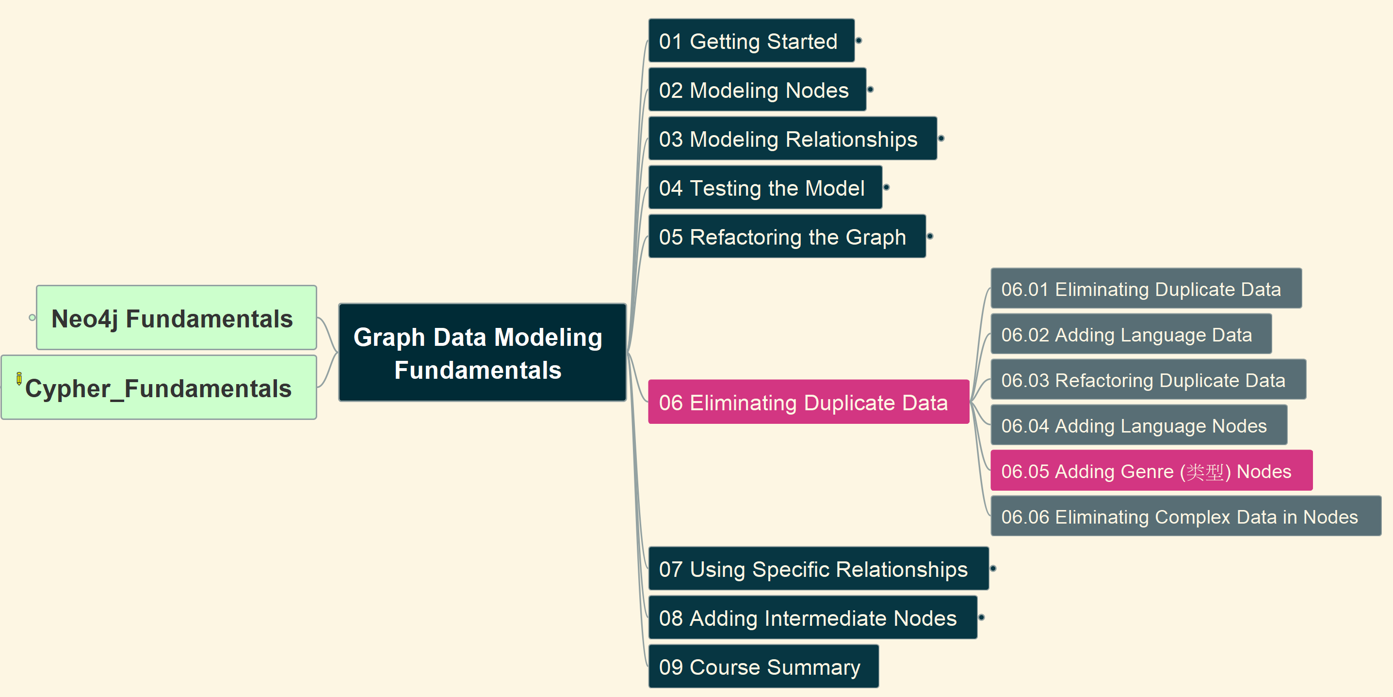
6. Eliminating Duplicate Data (4)
Graph Data Modeling Fundamentals
17

Slide 19
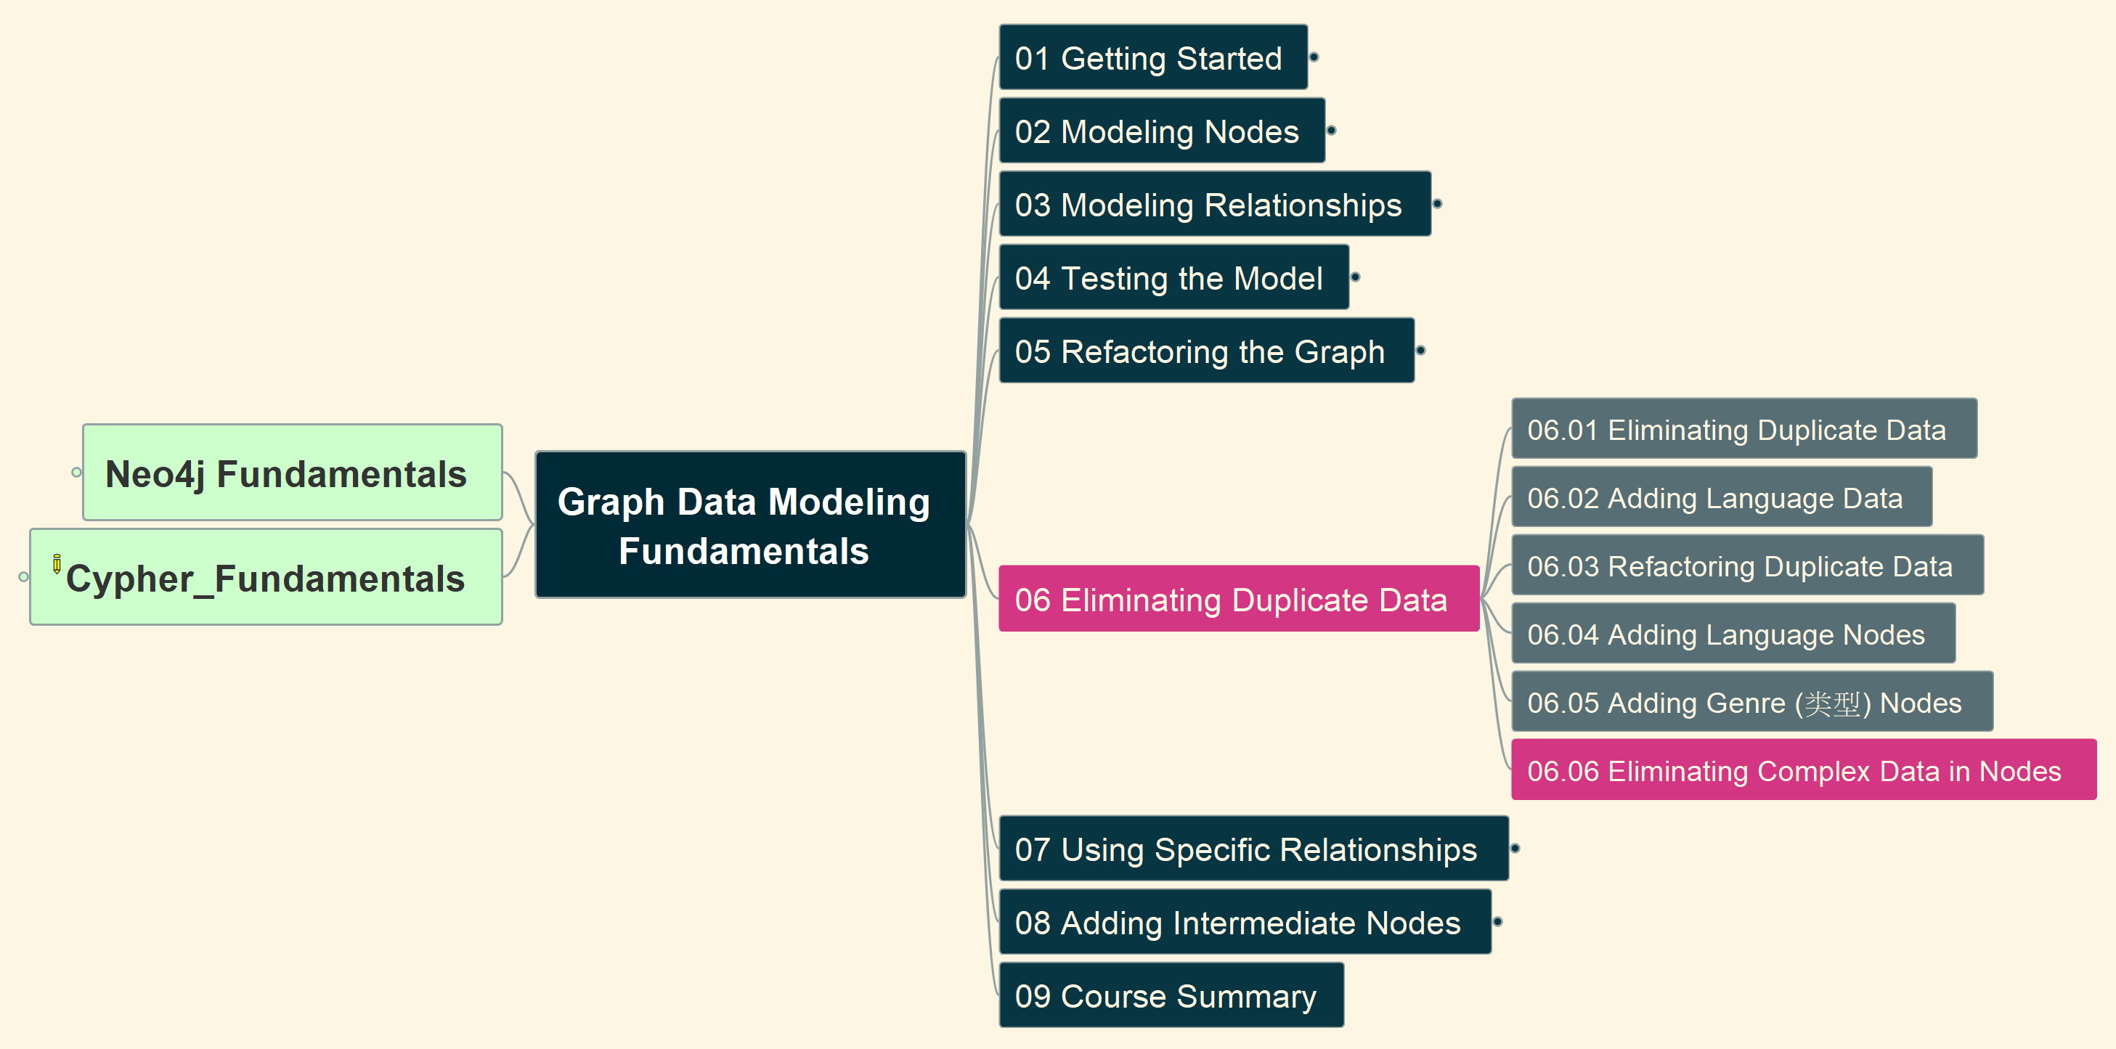
6. Eliminating Duplicate Data (5)
Graph Data Modeling Fundamentals
18

Slide 20
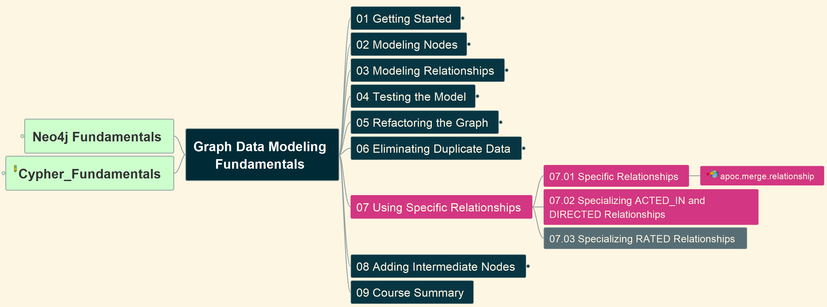
7. Using Specific Relationships (1)
Graph Data Modeling Fundamentals
19

Slide 21
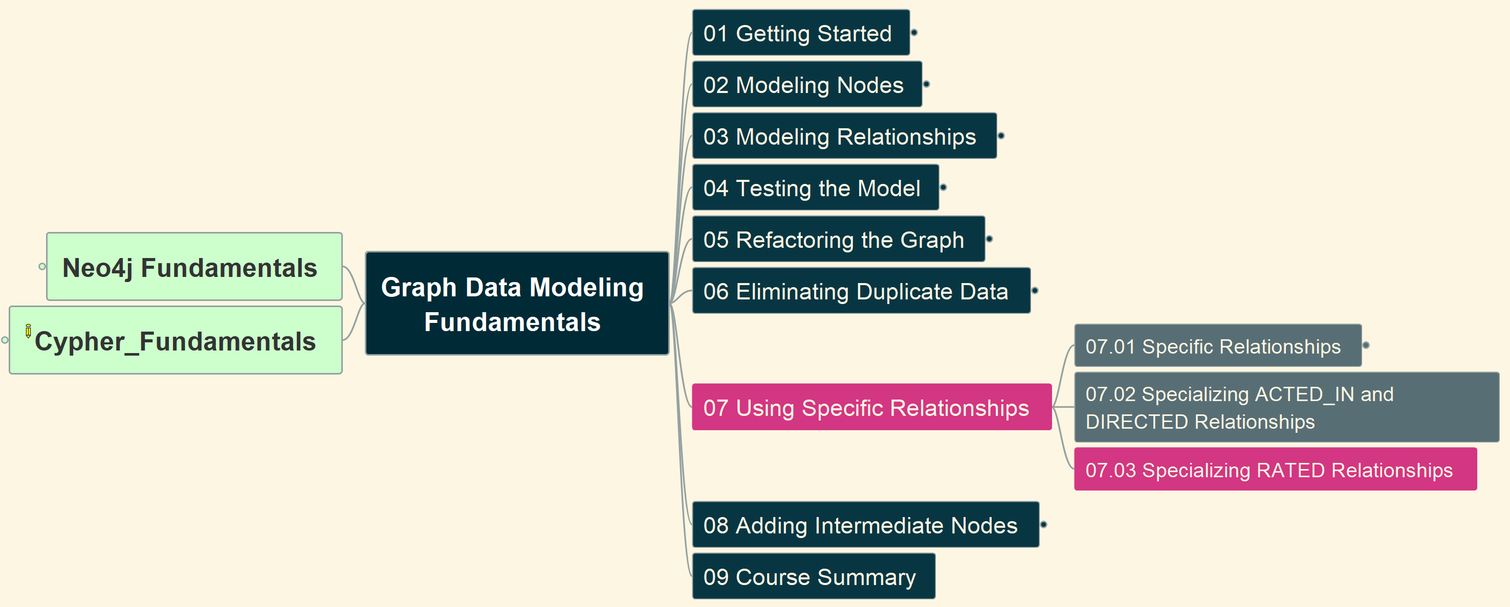
7. Using Specific Relationships (2)
Graph Data Modeling Fundamentals
20

Slide 22
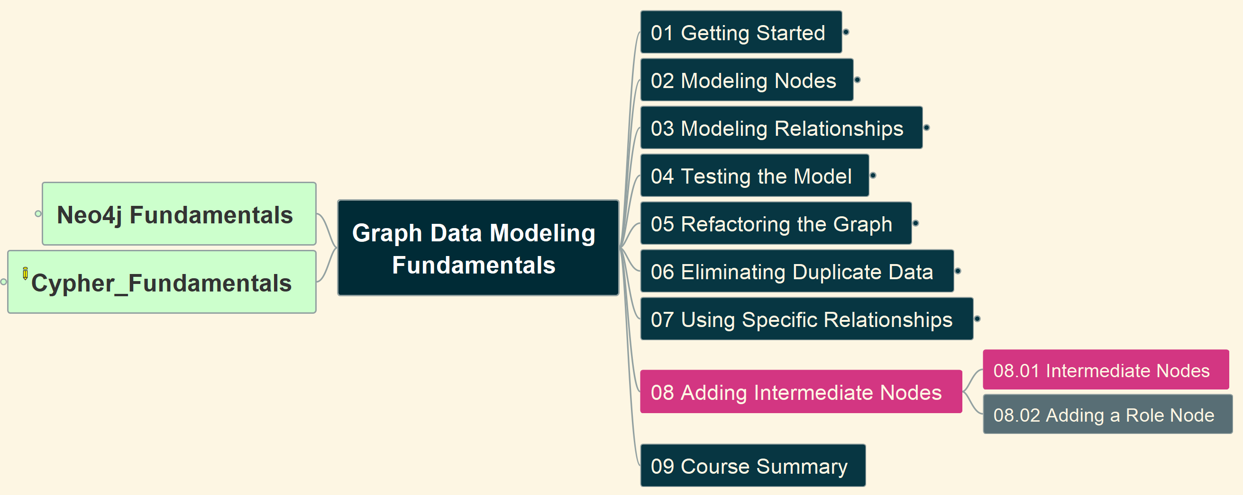
8. Adding Intermediate Nodes (1)
Graph Data Modeling Fundamentals
21

Slide 23
8. Adding Intermediate Nodes (2)
Graph Data Modeling Fundamentals
22

Slide 24
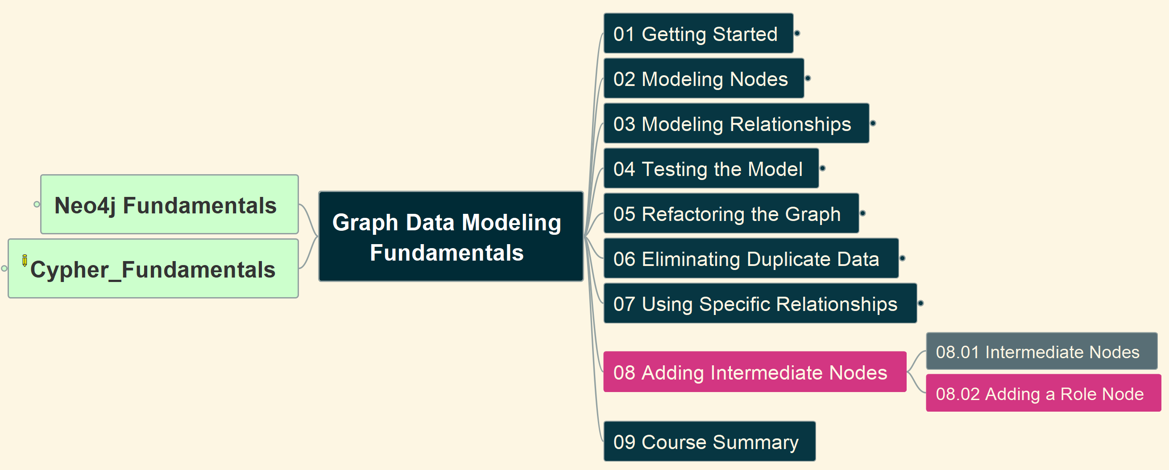
8. Adding Intermediate Nodes (3)
Graph Data Modeling Fundamentals
23

Slide 25
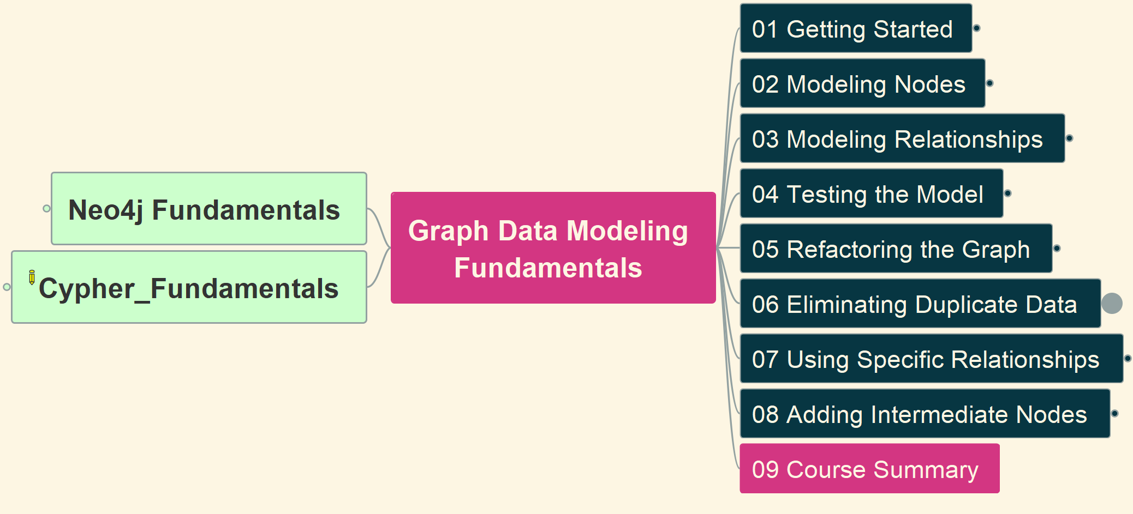
9. Course Summary
Graph Data Modeling Fundamentals
24

Slide 26
Course Summary
99
Intermediate
Intermediate Cypher Queries
Cypher Aggregations
Importing CSV data into Neo4j
Cypher Indexes and Constraints
Neo4j & GenerativeAI Fundamentals
Introduction to Vector Indexes and Unstructured Data
Building Neo4j Applications with Spring Data
Using Neo4j with Python
Building Neo4j Applications with Node.js
Building Neo4j Application with TypeScript
Developing with Neo4j MCP Tools
Using Neo4j with Java
Using Neo4j with Go
Building Neo4j Applications with .NET
Introducion to Neo4j & GraphGL
Beginners
Neo4j Fundamentals
Cypher Fundamentals
Graph Data Modeling Fundamentals
Importing Data Fundamentals
Aura Fundamentals
Advanced
Using Neo4j with LangChain
Build a Neo4j-backed Chatbot using Python
Build a Neo4j-backed Chatbot with TypeScript
Building Knowledge Graphs with LLMs
Path Finding with GDS
Neo4j Graph Data Science Fundamentals
Neo4j Graph Data Science Certification
Introduction to Neo4j Graph Data Science
Neo4j Certified Professional
Cypher Patterns
Cypher Statement Processing

Slide 27
